Slide 1
Golden Section Search Method
by
Dr. Md. Rajibul Islam
CSE, UAP

Slide 2
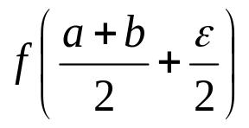
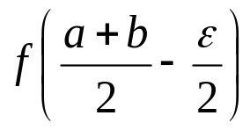
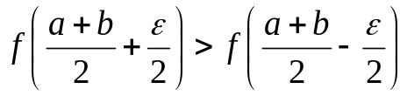
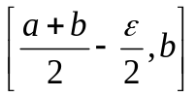

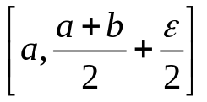
Equal Interval Search Method
Choose an interval [a, b] over which the optima occurs
Compute and
f(x)
Opt.
If
then the interval in which the maximum occurs is otherwise it occurs in
a
b
x
(a+b)/2
Figure 1 Equal interval search method.

Slide 3
Golden Section Search Method
The Equal Interval method is inefficient when ε is small.
The Golden Section Search method divides the search more efficiently closing in on the optima in fewer iterations.
f₂
f₁
f_{l}
f_{u}
X_{l}
X₂
X₁
X_{u}
Figure 2. Golden Section Search method

Slide 4
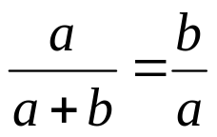
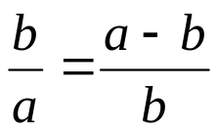
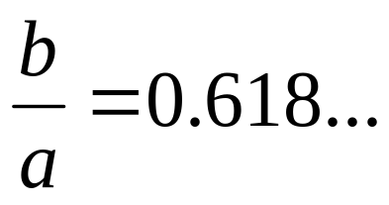
Golden Section Search Method-Selecting the Intermediate Points
f₁
f₂
f₁
f_{l}
f_{u}
f_{l}
f_{u}
a-b
b
X_{l}
X₁
X_{u}
X_{l}
X₂
X₁
X_{u}
a
b
a
Determining the first intermediate point
Determining the second intermediate point
Golden Ratio=>

Slide 5

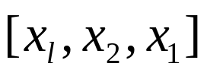


Golden Section Search-
Determining the new search region
f₂
f₁
f_{l}
f_{u}
X_{l}
X₂
X₁
X_{u}
If then the new interval is
If then the new interval is
All that is left to do is to determine the location of the second intermediate point.

Slide 6



Example
.
2
2
θ
2
θ
The cross-sectional area A of a gutter with equal base and edge length of 2 is given by
Find the angle θ which maximizes the cross-sectional area of the gutter. Using an initial interval of find the solution after 2 iterations. Use an initial .

Slide 7


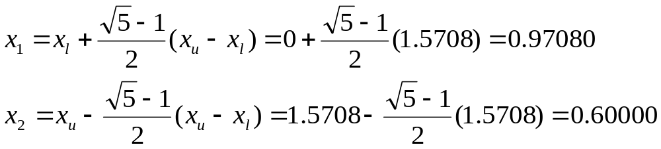


Solution
The function to be maximized is
Iteration 1: Given the values for the boundaries of
we can calculate the initial intermediate points as follows:
f₁
f₂
X₁=?
X_{l}=X₂
X₂=X₁
X_{u}
X_{l}
X₂
X₁
X_{u}

Slide 8
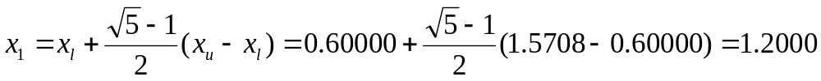



Solution Cont
To check the stopping criteria the difference between and is calculated to be

Slide 9
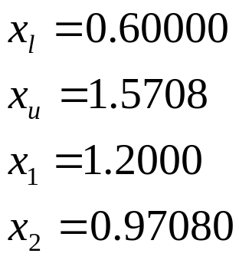



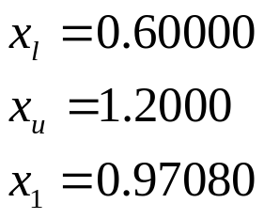
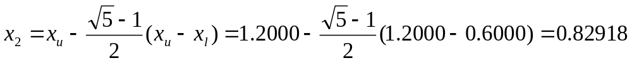
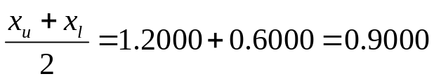
Solution Cont
Iteration 2
X_{l}
X₂
X₁
X_{u}

Slide 10
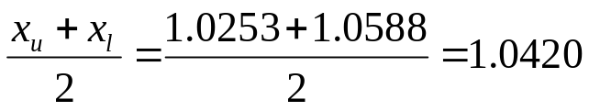

Theoretical Solution and Convergence
Iteration | x_{l} | x_{u} | x₁ | x₂ | f(x₁) | f(x₂) | ε
1 | 0.0000 | 1.5714 | 0.9712 | 0.6002 | 5.1657 | 4.1238 | 1.5714
2 | 0.6002 | 1.5714 | 1.2005 | 0.9712 | 5.0784 | 5.1657 | 0.9712
3 | 0.6002 | 1.2005 | 0.9712 | 0.8295 | 5.1657 | 4.9426 | 0.6002
4 | 0.8295 | 1.2005 | 1.0588 | 0.9712 | 5.1955 | 5.1657 | 0.3710
5 | 0.9712 | 1.2005 | 1.1129 | 1.0588 | 5.1740 | 5.1955 | 0.2293
6 | 0.9712 | 1.1129 | 1.0588 | 1.0253 | 5.1955 | 5.1937 | 0.1417
7 | 1.0253 | 1.1129 | 1.0794 | 1.0588 | 5.1908 | 5.1955 | 0.0876
8 | 1.0253 | 1.0794 | 1.0588 | 1.0460 | 5.1955 | 5.1961 | 0.0541
9 | 1.0253 | 1.0588 | 1.0460 | 1.0381 | 5.1961 | 5.1957 | 0.0334
=x_{u}-x₁
The theoretically optimal solution to the problem happens at exactly 60 degrees which is 1.0472 radians and gives a maximum cross-sectional area of 5.1962.

Slide 11
THE END

